Slide 1
Clause Ease -AI Based Contract Language Simplifier
Presented By - Group-5
Y.Bhavya Sri
M.Subrajit
MENTOR: KALAIVANI A B.Yasokeerthi
Infosys SpringBoard Virtual Internship 6.0

Slide 2

Introduction
Legal contracts are often written in complex and
technical language, making them hard to understand
for non-experts.
Our project, ClauseEase, uses Artificial Intelligence
to simplify these documents automatically.
It converts difficult legal text into clear, plain English
while keeping the original meaning intact.
The goal is to make legal information accessible and
understandable for everyone — not just lawyers.

Slide 3
ClauseEase AI – Simplifying Legal Language
The Challenge
Legal documents are filled with long, complex sentences and jargon.
People often struggle to understand what they’re agreeing to.
Misinterpretation can lead to costly mistakes or legal disputes.
The Solution – ClauseEase AI
AI-Powered Simplification: Analyzes and simplifies complex legal text instantly.
Smart Insights: Highlights key clauses, obligations, and potential risks.
Plain-Language Output: Converts legal jargon into simple, easy-to-read summaries.
Seamless Integration: Works with PDFs, Word files, and email attachments.

Slide 4
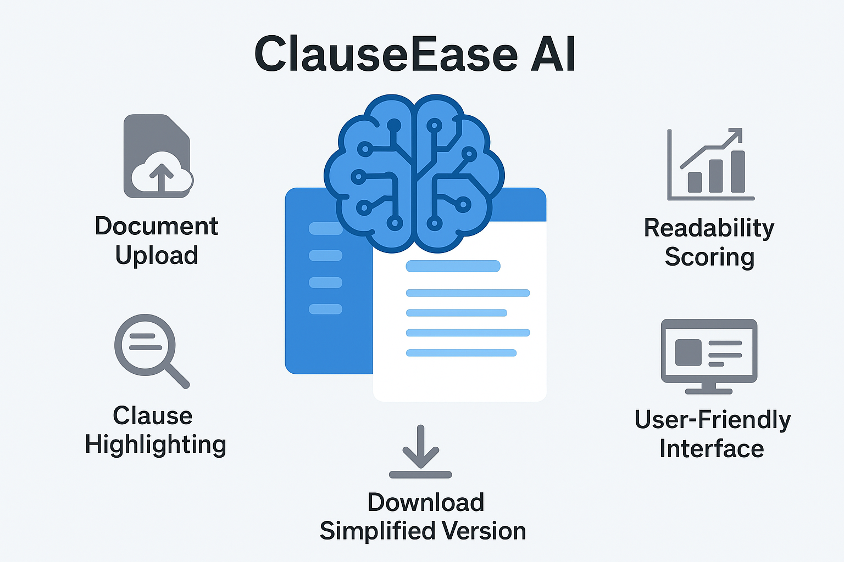
Key Features
Document Upload: Supports PDF, DOCX, and text files.
AI-Powered Simplification: Uses NLP models to rewrite complex legal clauses.
Readability Scoring: Displays readability metrics using tools like textstat.
Clause Highlighting: Highlights difficult legal terms and provides easy definitions.
Download Simplified Version: Users can download the simplified version for reference.
User-Friendly Interface: Built using Streamlit for an interactive and intuitive experience.

Slide 5
Modules to be Implemented
1. Document Ingestion
Upload PDF/DOCX/TXT files
Extract and clean raw text (using PyMuPDF, python-docx)
2. Text Preprocessing
Tokenization, lemmatization, stop-word removal
Normalize text for NLP analysis
3. Legal Clause Detection
Identify and segment legal clauses
Classify clauses (e.g., Confidentiality, Liability, Termination)

Slide 6
4. Legal Term Recognition
Detect legal jargon and complex terms (via NER)
Map to simplified meanings or glossary
5. Language Simplification
AI-based rephrasing using transformer models (T5/BART)
Simplify while preserving meaning and context
Measure readability (Flesch, Gunning Fog Index)
6. Contextual Linking
Maintain link between original and simplified clauses
Ensure logical consistency and smooth readability
Display both versions side-by-side in the UI

Slide 7
Technology Stack Overview
CATEGORY | TOOLS / LIBRARIES
Frontend UI | Streamlit
NLP Processing | spaCy, NLTK
Readability Metrics | textstat
AI Models | Hugging Face Transformers (T5, BART)
PDF Processing | PyMuPDF (fitz)
Data Storage | JSON files
Backend Language | Python 3
Styling | Custom CSS & HTML

Slide 8
Main Functional Modules
⇨ Login & Registration System
⇨Global Styling and Animated Background
⇨Text Preprocessing Functions
⇨Readability Analysis
⇨Hugging Face Model Integration
⇨Glossary Highlighting
⇨Logging System for Admin Review

Slide 9
Main Dashboard Layout
Sidebar contains settings and options:
o Lowercasing
o POS/Token display
o Simplification Level
o Summarization toggle
o Glossary highlighting
• Main area contains:
o Text input or PDF uploader
o Readability metrics (cards)
o Basic text statistics
o Optional sentence/token/POS tables
o Summary section
o Simplified text (side-by-side view)
o Download buttons for results

Slide 10
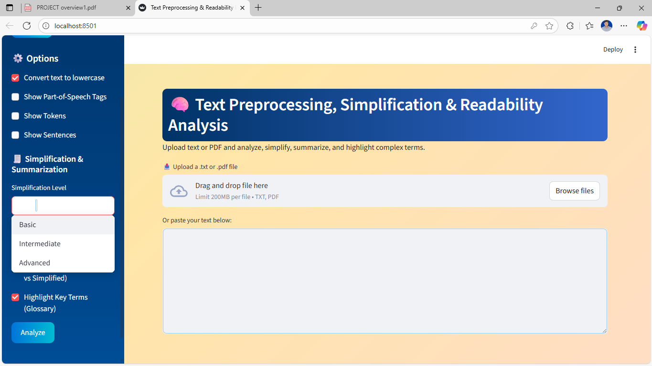
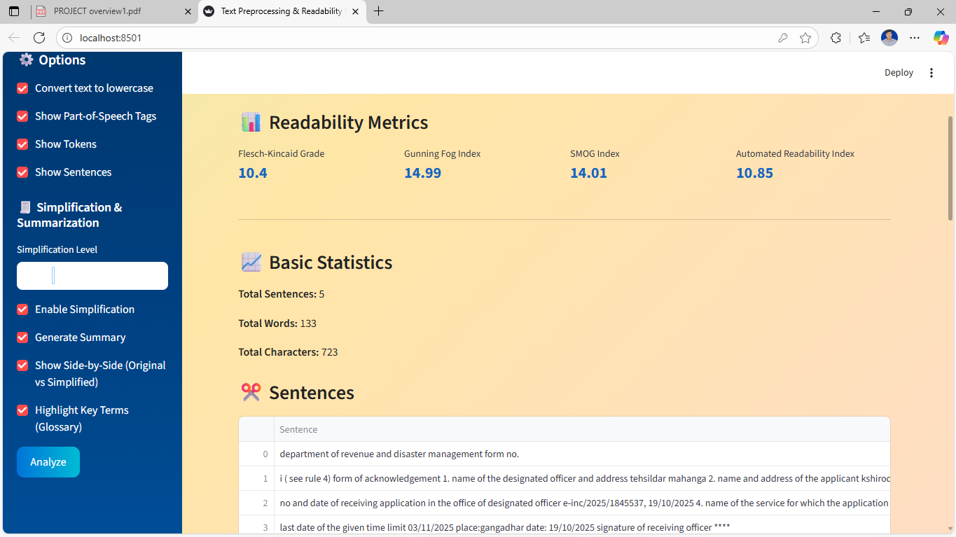
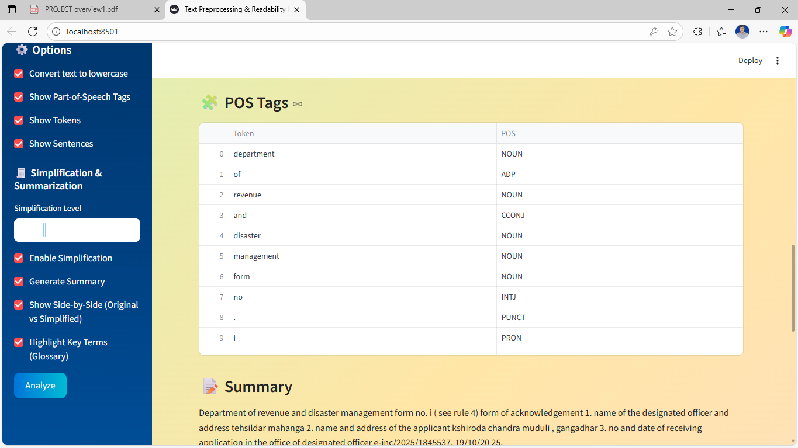
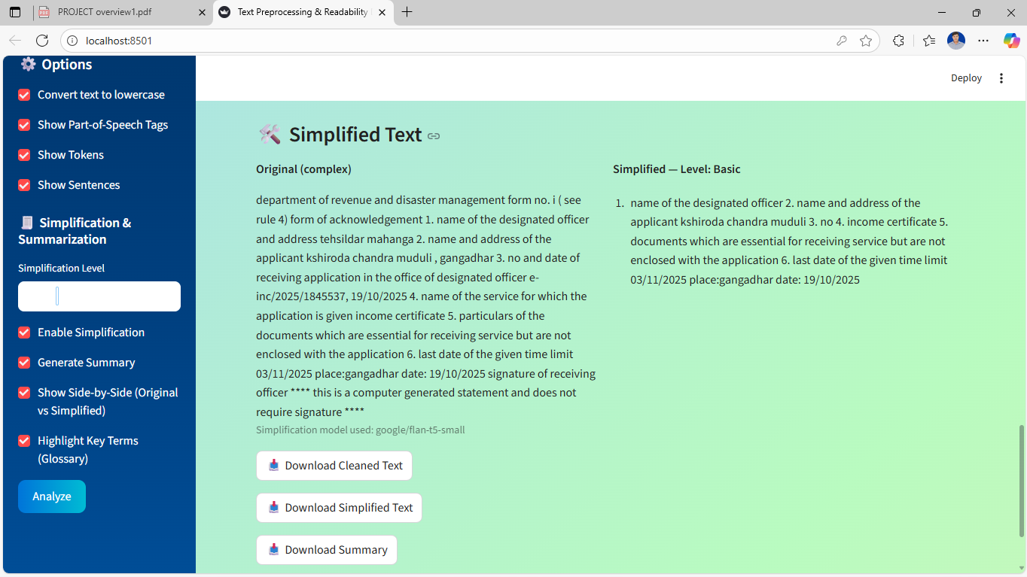

Slide 11
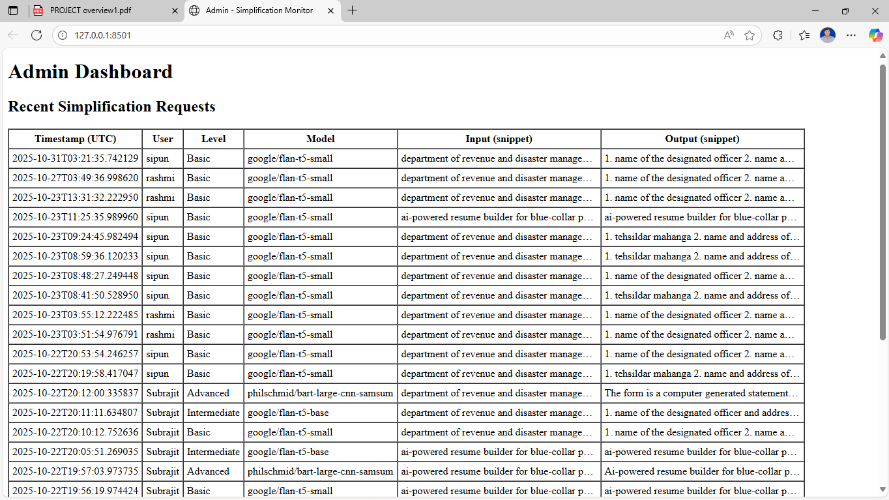
Admin Dashboard

Slide 12
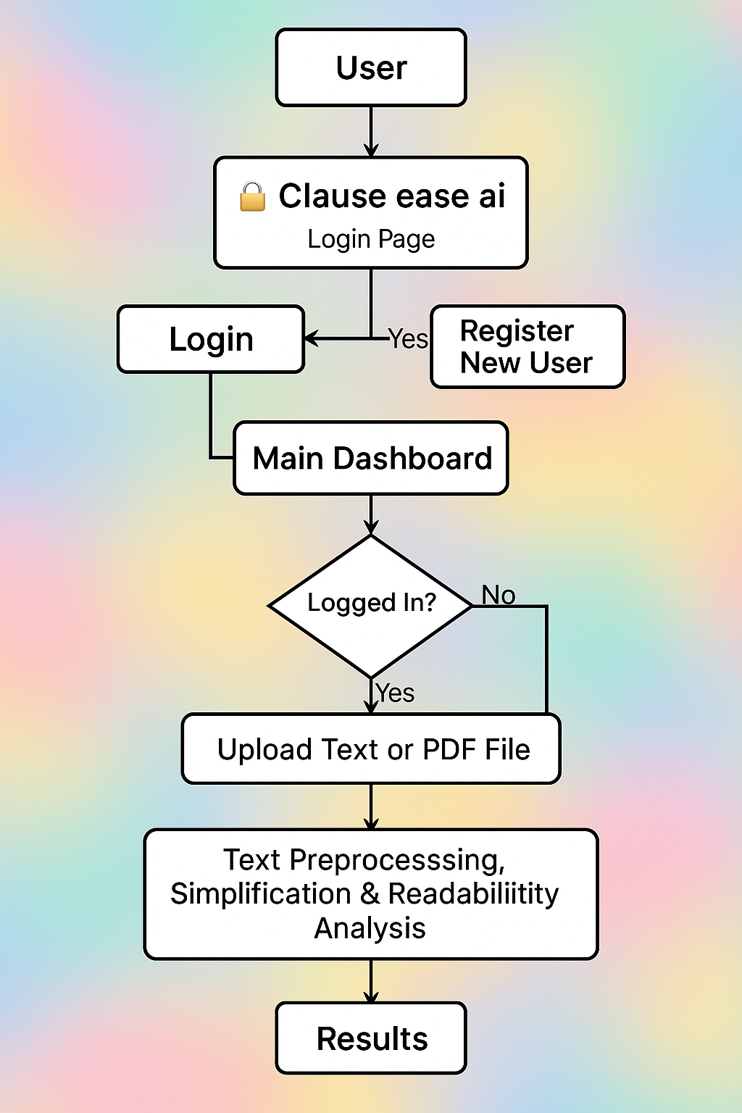
WORKFLOW DIAGRAM CLAUSE EASE AI

Slide 13
Functional Outcomes
ClauseEase AI automatically simplifies complex legal and policy text using Transformer models (FLAN-T5, BART).
Implements text preprocessing (cleaning, tokenization, POS tagging) using spaCy and NLTK.
Calculates readability metrics such as Flesch-Kincaid, Gunning Fog, and SMOG via textstat.
Built on Streamlit with secure login/registration, real-time visualization, and side-by-side comparison of original vs simplified text.Supports PDF, DOCX, and TXT input formats through PyMuPDF and python-docx.

Slide 14
Interface and Usability Outcomes
Modern animated interface using custom CSS for gradients and glowing effects.
Sidebar controls for simplification level (Basic → Advanced), summarization toggle, and glossary highlighting.
Readability metric cards display word count, readability scores, and simplification results.
Improved user experience through a clean layout and smooth navigation.

Slide 15
Admin and System Performance
Integrated logging system records timestamp, user, model used, and text snippets for each simplification.
Enables admin monitoring and performance review.Secure multi-user sessions implemented via st.session_state.
Docker-ready and deployable on Streamlit Cloud or Hugging Face Spaces.Ensures data privacy and controlled access for all users.

Slide 16
Real-World Impact Accessibility:
Makes legal and academic language understandable to non-experts.
Transparency: Reduces confusion and improves clarity in contracts and policies.
Efficiency: Saves time by automating manual simplification tasks.
Education: Helps students and researchers grasp dense technical texts.
Social Value: Encourages fair and clear communication in legal and government contexts.

Slide 17
Conclusion
ClauseEase AI shows how AI and NLP can convert technical legal content into plain English.
Achieved complete automation from upload → preprocessing → simplification → readability evaluation.
Strengthens communication between experts and the public, reducing misinterpretation.
A strong example of AI for social good — combining technology, usability, and accessibility.

Slide 18
THANK YOU

